Slide 1

BURP SUITE & SOAP UI
MD. Sajedul Islam Sajib (011201064)
Amina Afroz (011201391)
Tawhidul Islam (011192118)
Takwa Akter (011191185)
Ananna gosh (011191268)

Slide 2
Description of Burp Suite
Burp Suite is a leading web application security testing tool used by cybersecurity professionals to identify and fix vulnerabilities in web applications. It provides a comprehensive set of features, including proxy, scanner, intruder, and more, to help ensure the security of web-based systems.

Slide 3
PROXY
Burp Proxy operates as a web proxy server between the browser and target applications. It enables intercept, inspect, and modify traffic that passes in both directions.

Slide 4
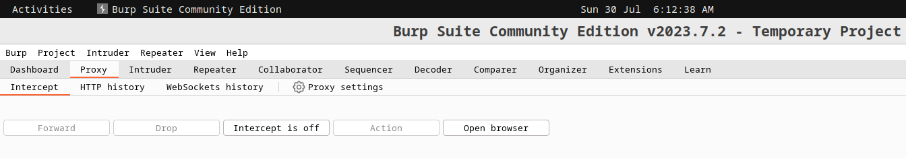
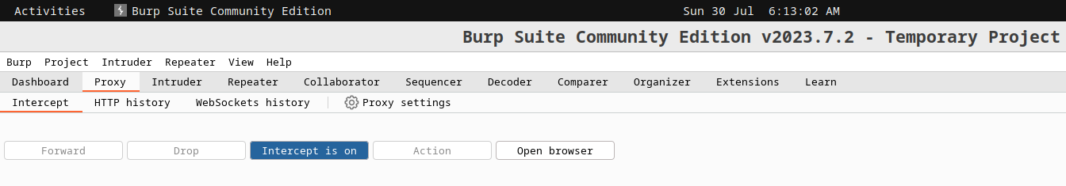
Experiment Design
Proxy Setup:

Slide 5
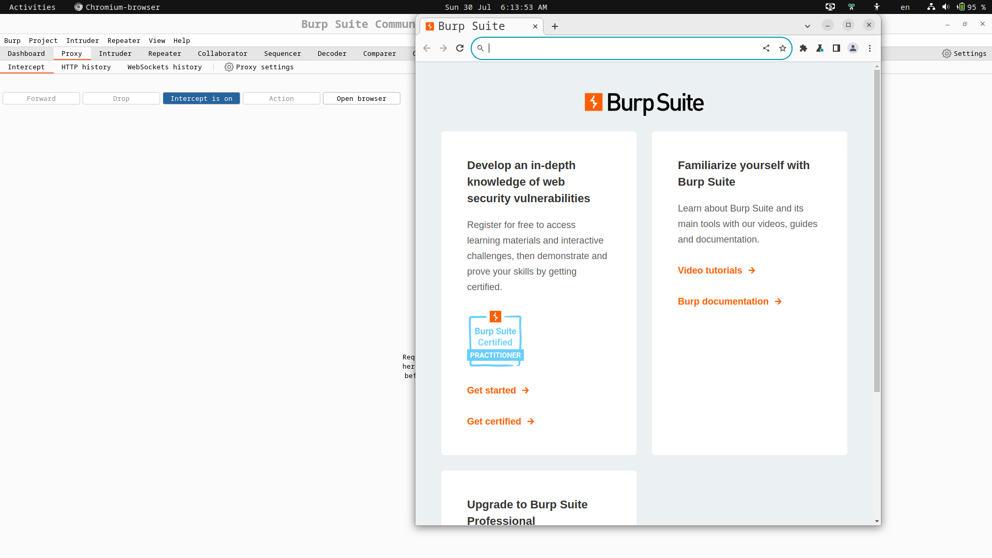
Proxy Setup:

Slide 6
Test Selection:
1.Intercept a Request.
2.Modifying the HTTP Request.
3.View and Analysis HTTP History.

Slide 7
Test Step of Intercept Request:

Slide 8
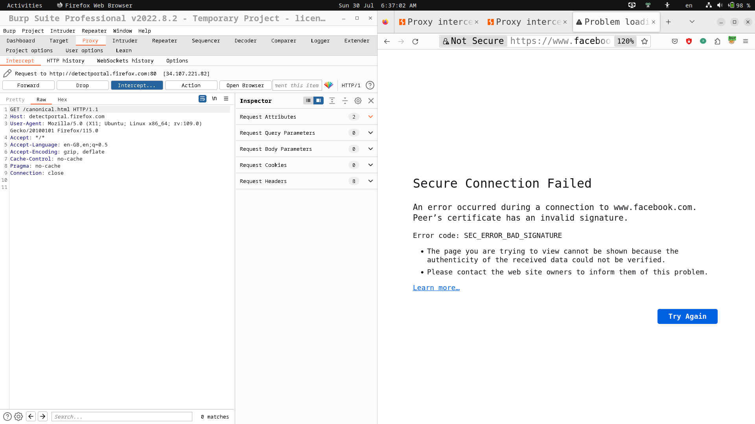

Slide 9
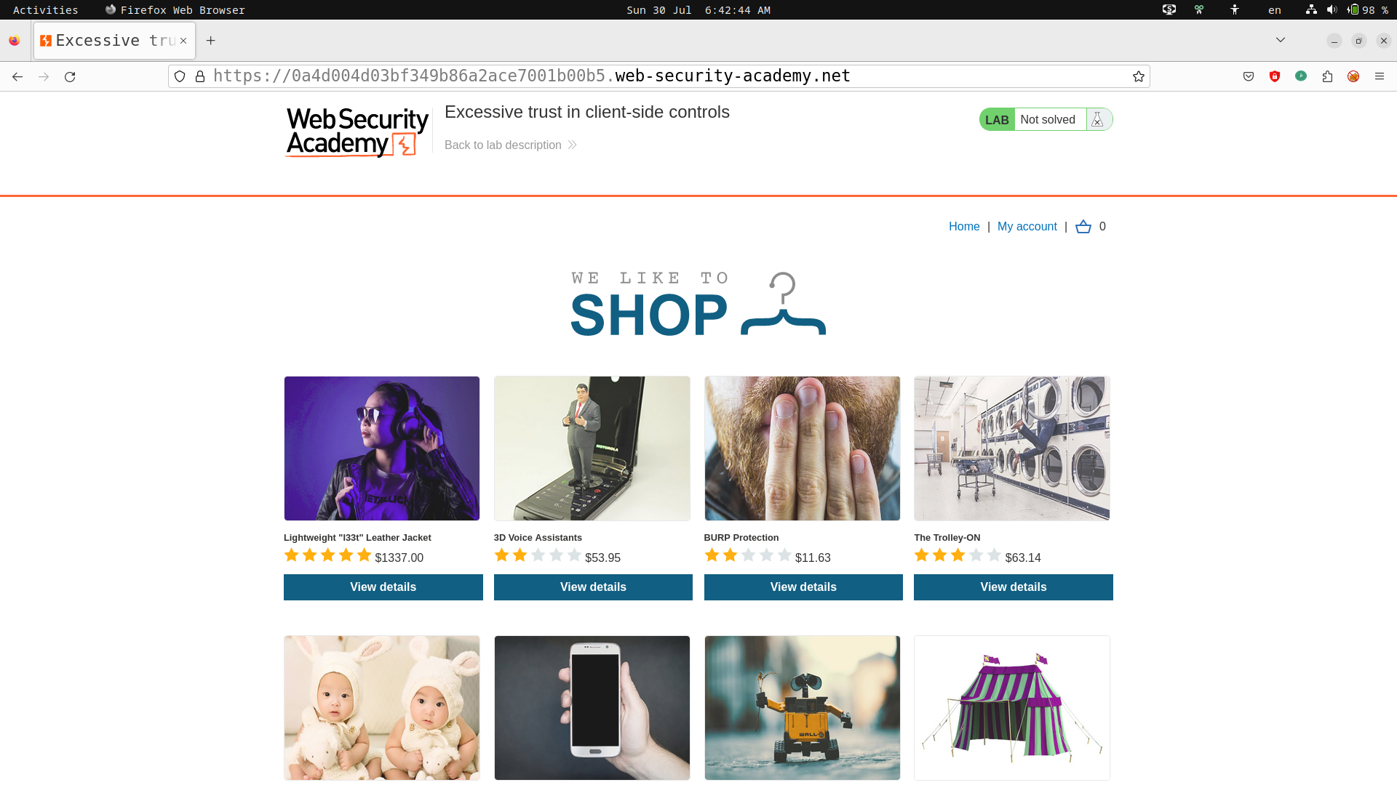
Test Step of Modifying the Request:
Step 1: Access the vulnerable website in Burp's browser.

Slide 10
Step 2: Log in to your shopping account
Username: wiener
Password: peter
Step 3: Select Something to Buy
Step 4:Select Add to cart
Step 5: Proxy>Intercept.Click Forward until find POST/cart request
Step 6:Then Modifying the Request

Slide 11
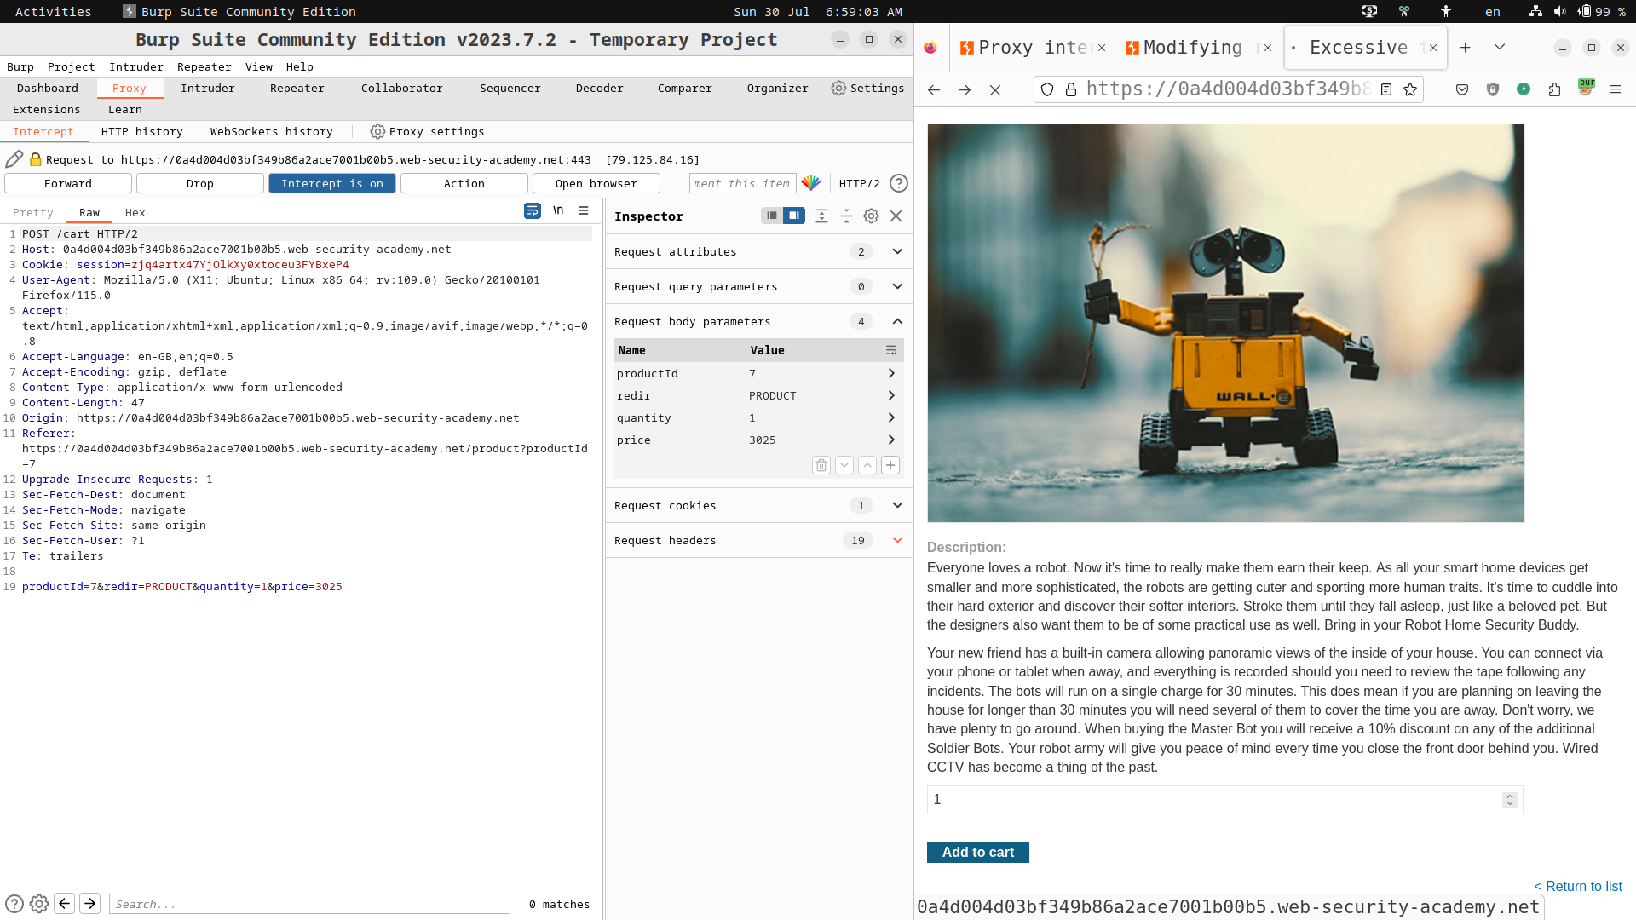

Slide 12


Slide 13
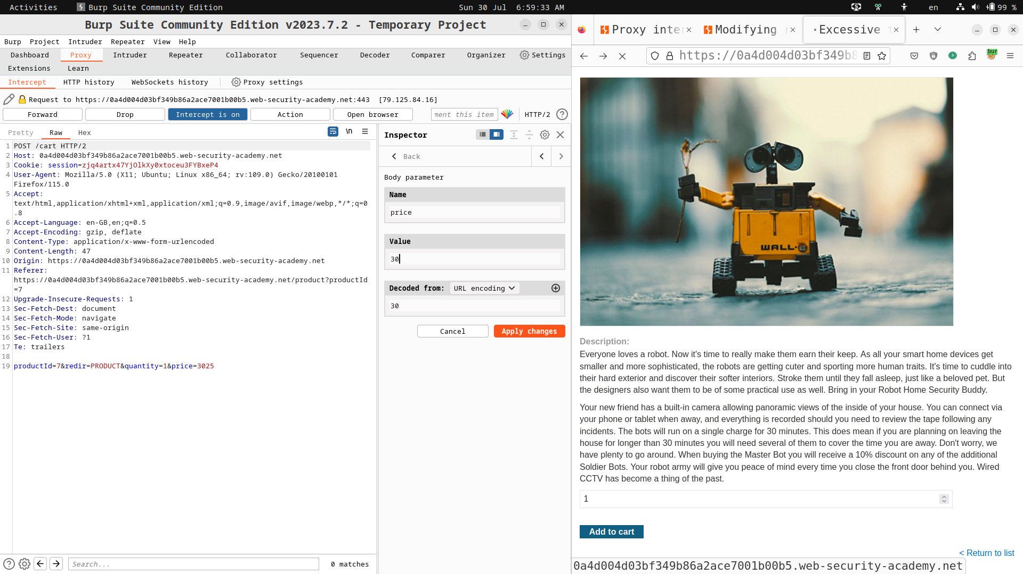

Slide 14
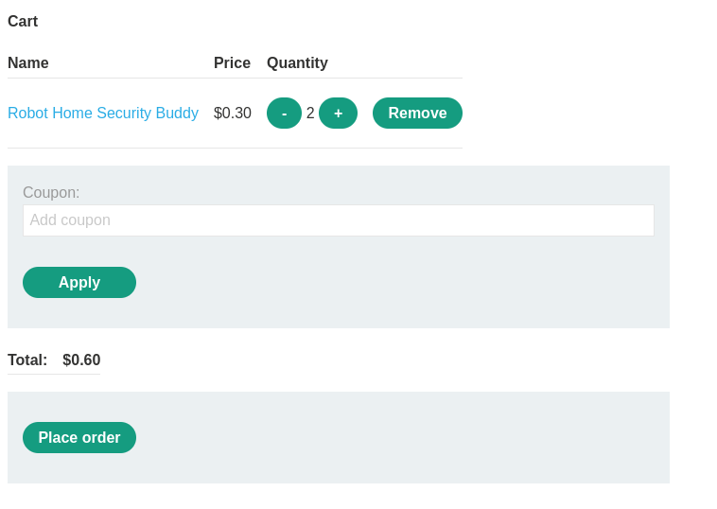
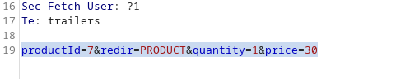

Slide 15
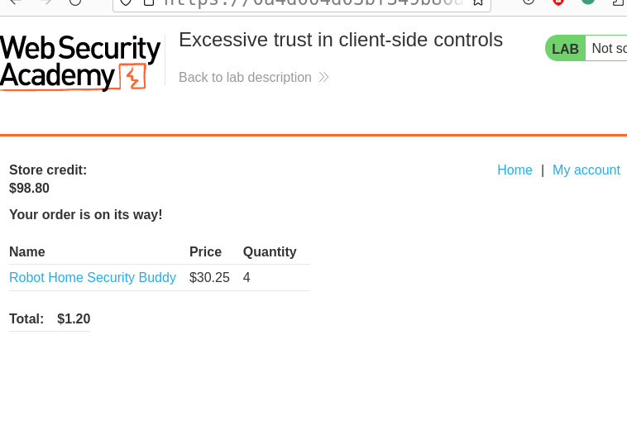

Slide 16
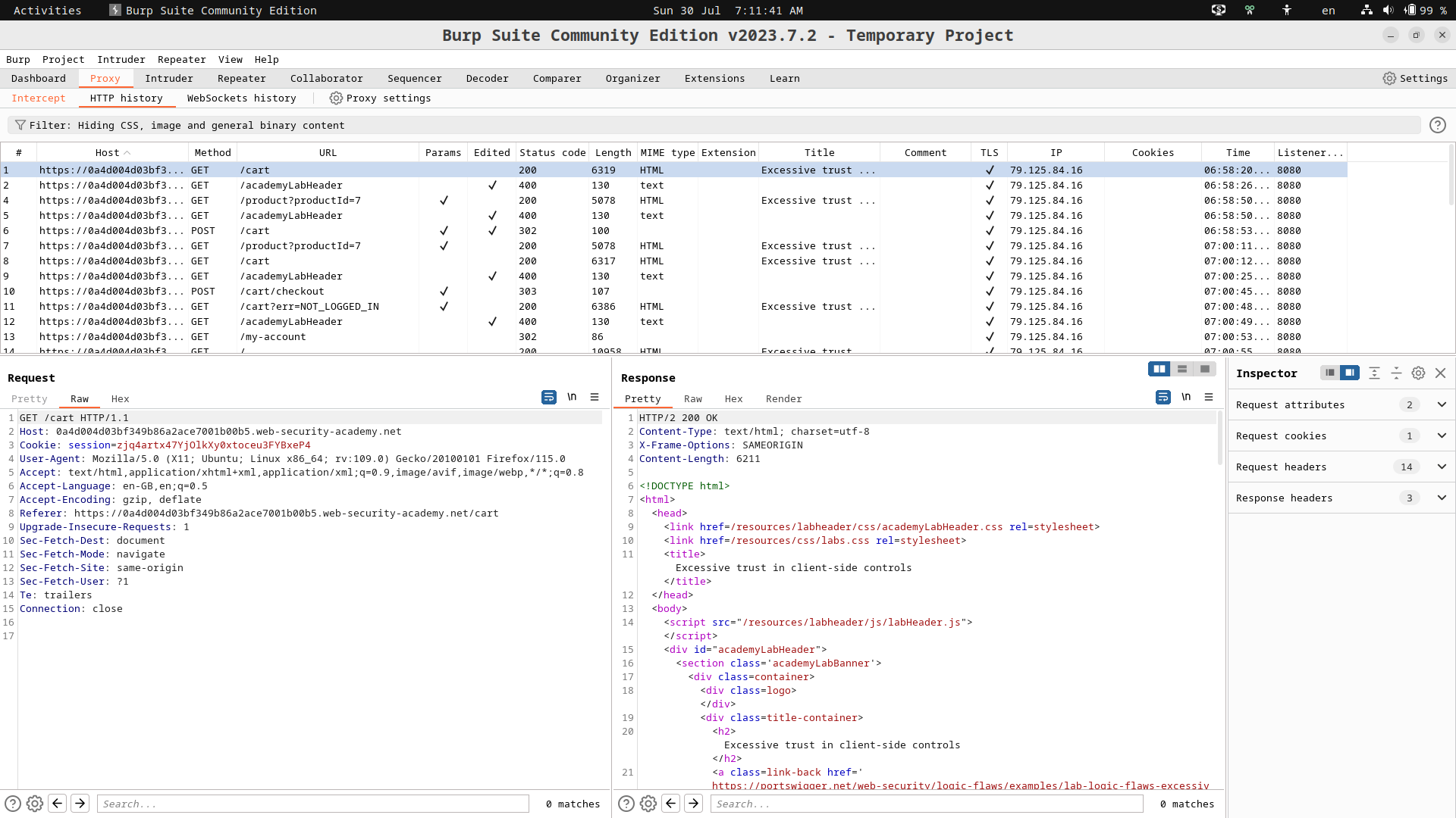
Test Step of View and Analysis:

Slide 17
Observation/ Result:
Burp Suite acts as a proxy between a web browser and the target website, allowing user to intercept and view HTTP requests and responses.Here I can analyze the data exchanged between the client and server.
I can also modify the data.I can modify the product price in HTTP Request then send it to the server and server proceed to the next step without any error.

Slide 18
Scan and Generate Report
Burp Scanner used as both a fully automated scanner and we can generate a report in HTML format, based on your scan results.

Slide 19
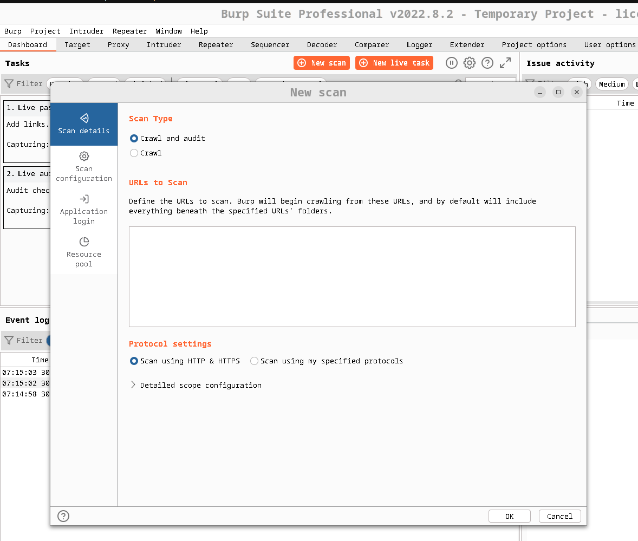
Experiment Design: (Set up)

Slide 20
Test Selection:
1. Scan a Website and find it vulnerabilities.
2. Analysis the vulnerabilities.
3. Generating a Report

Slide 21
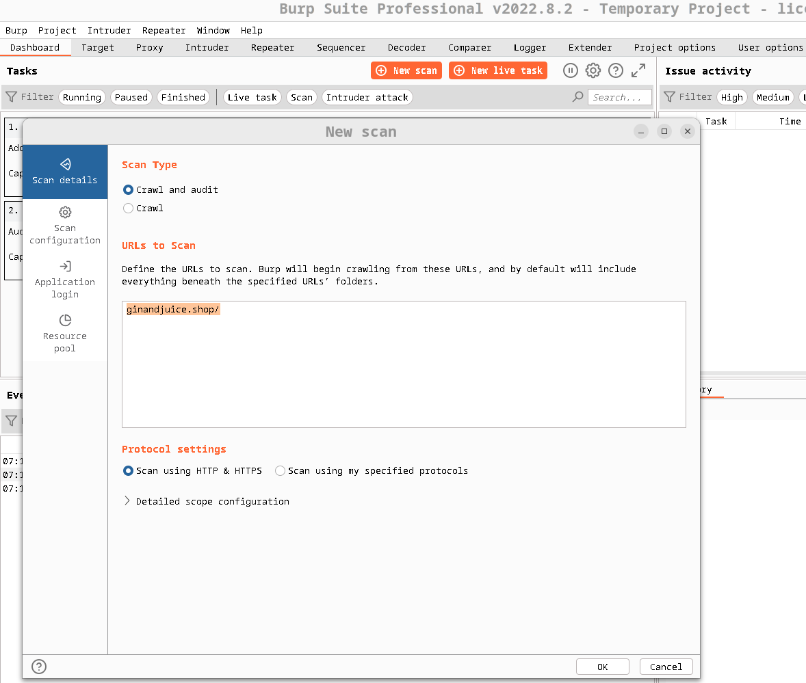
Test Step 01: Enter the URL of the target site

Slide 22
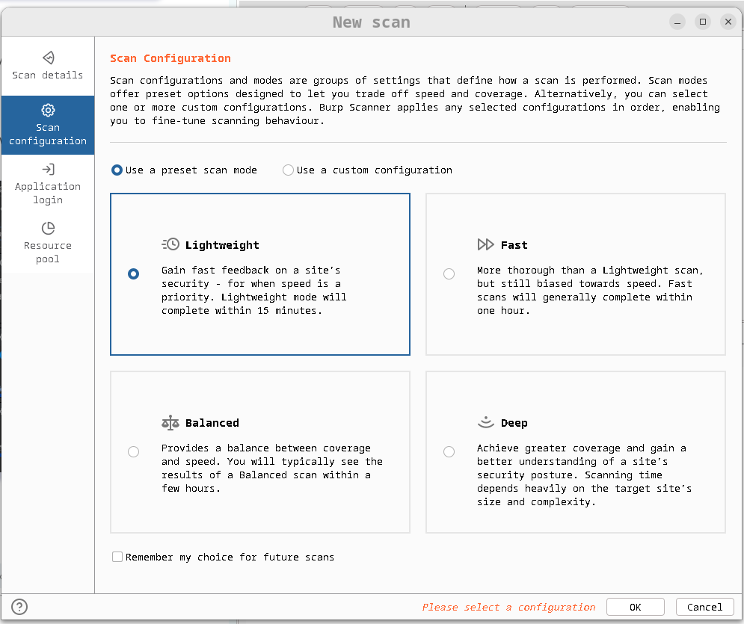
Test Step 02: Configure the scan

Slide 23
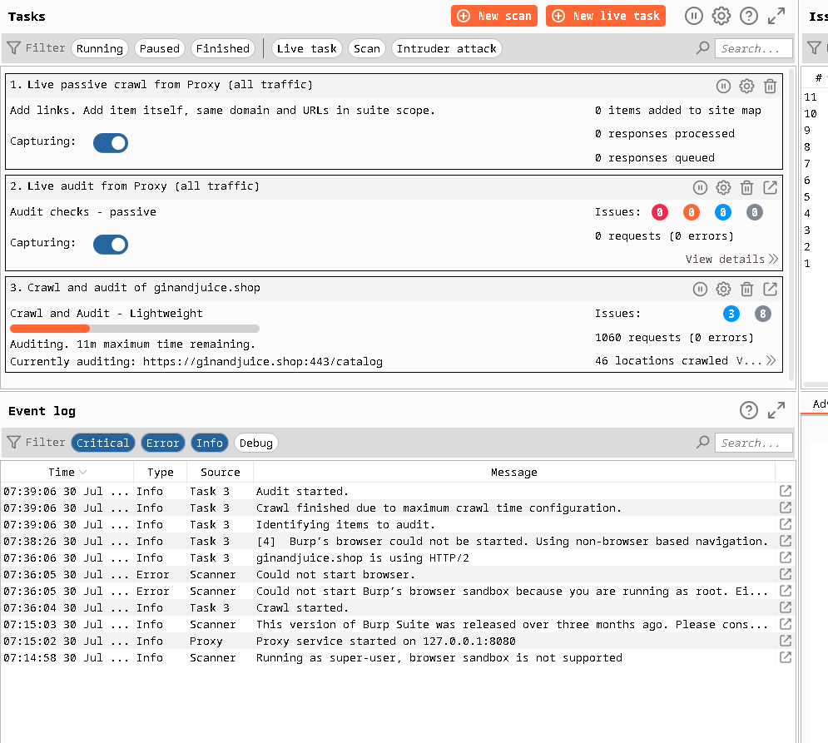
Test Step 03: Launch the scan

Slide 24
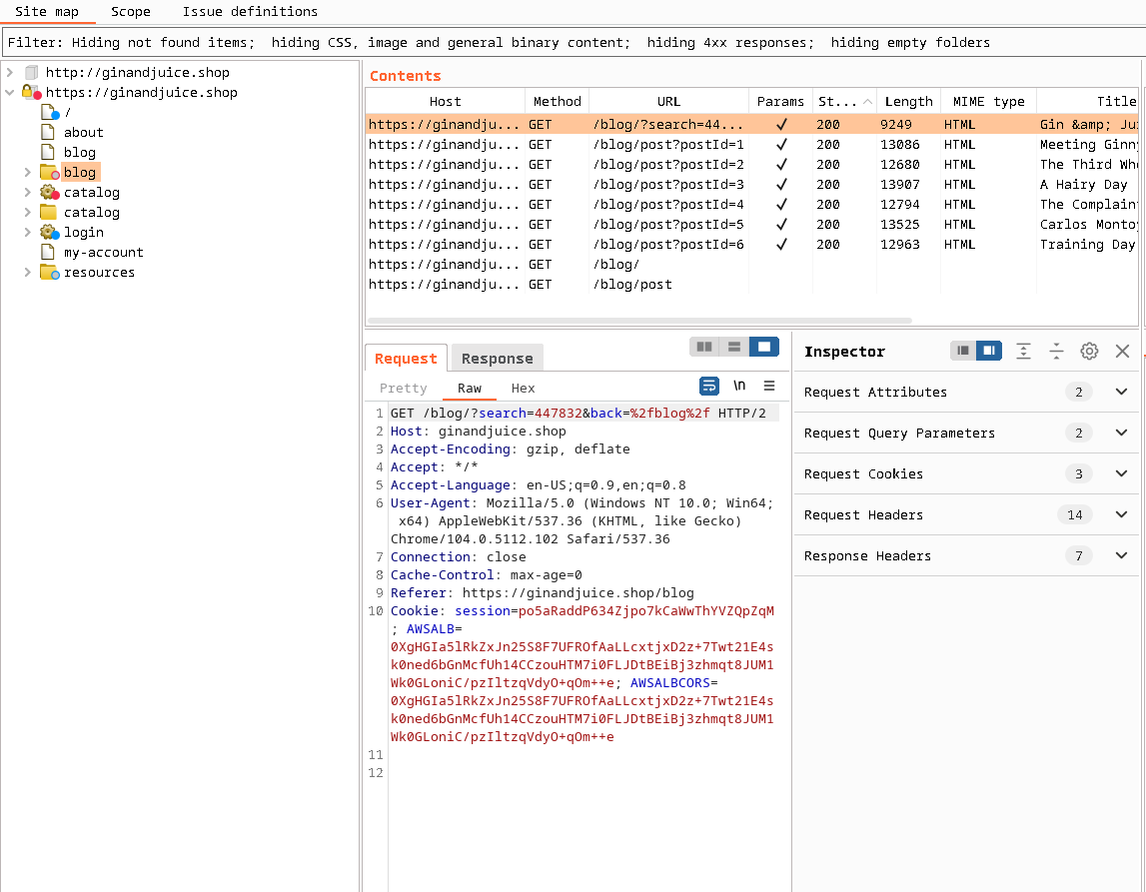
Test Step 04: See the crawl in action

Slide 25
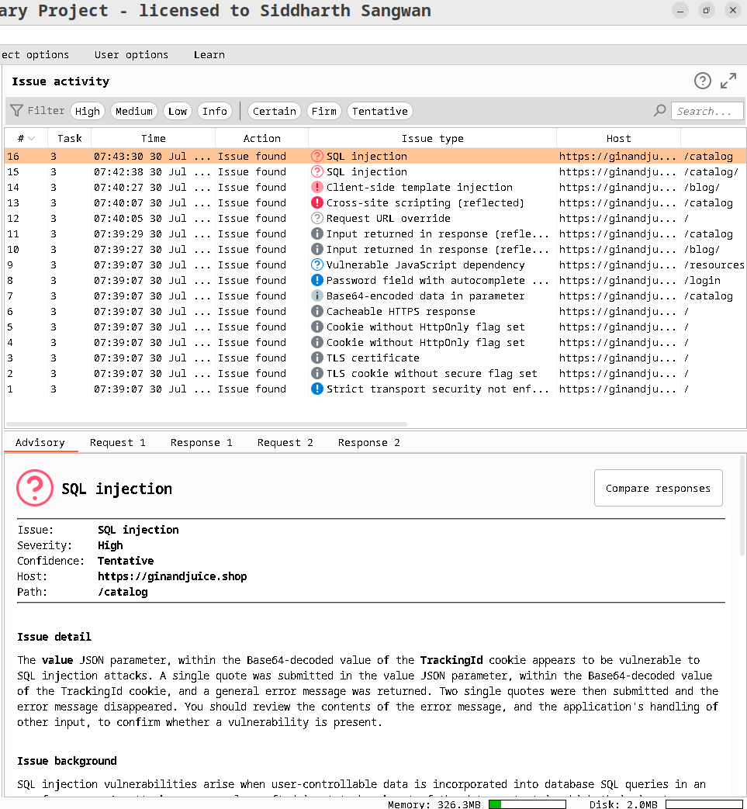
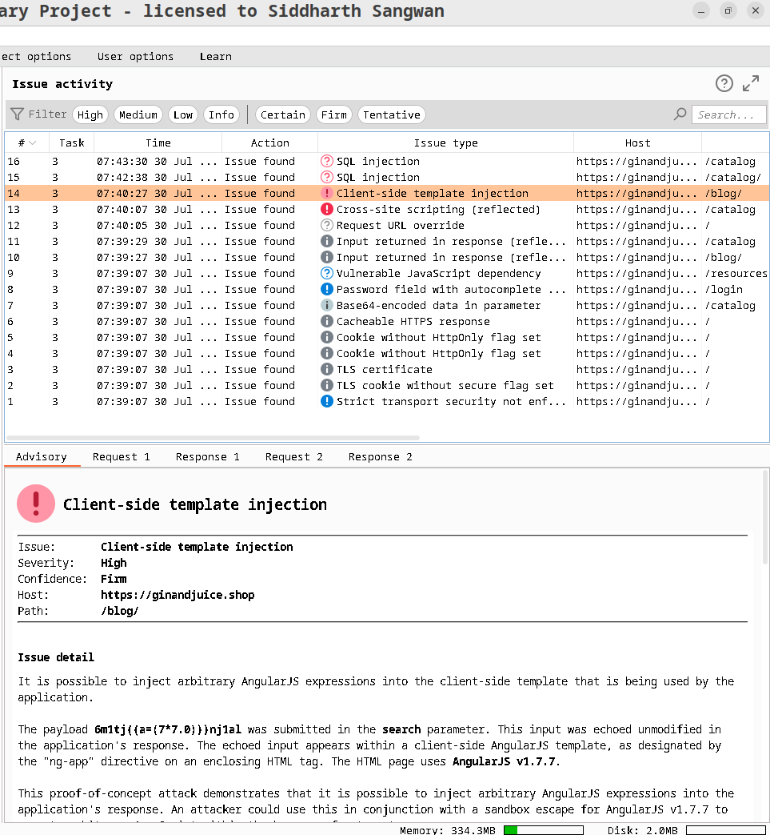
Test Step 05: View the identified issues

Slide 26
Test Step 05: View the identified issues

Slide 27
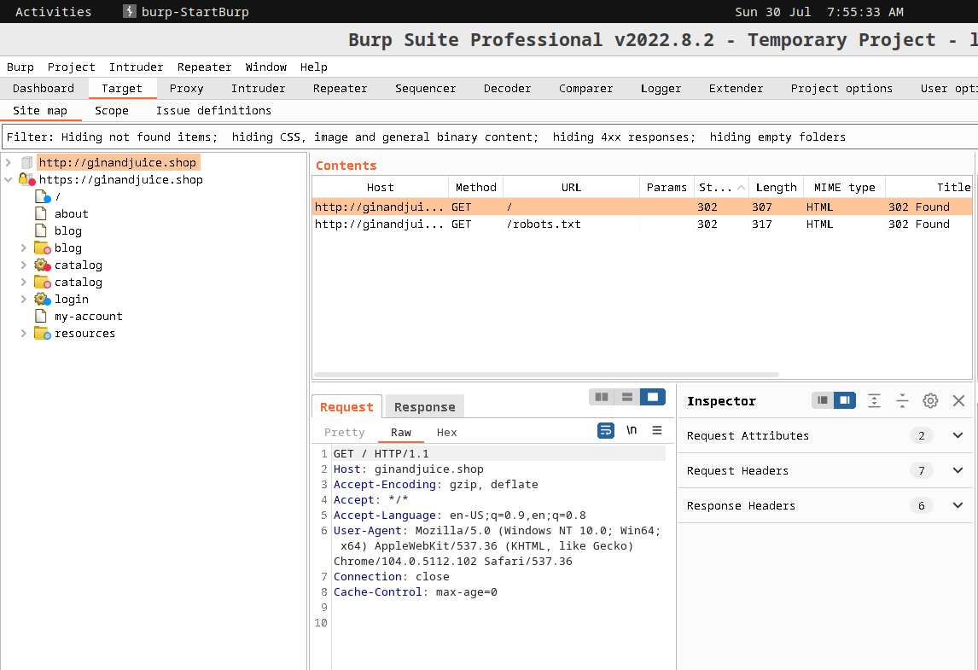
Generating a Report
Step 1:Select the relevant issues

Slide 28
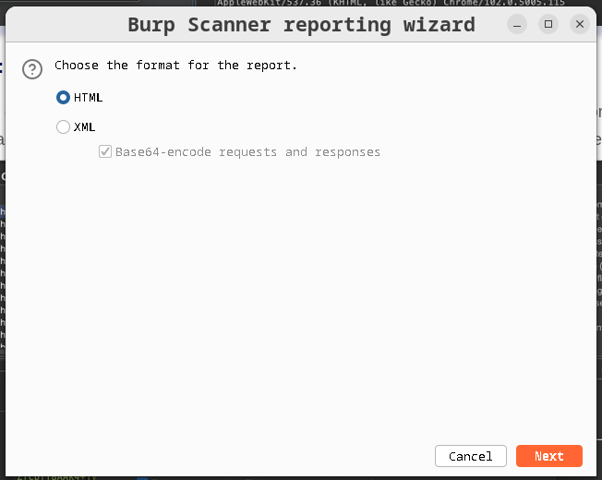
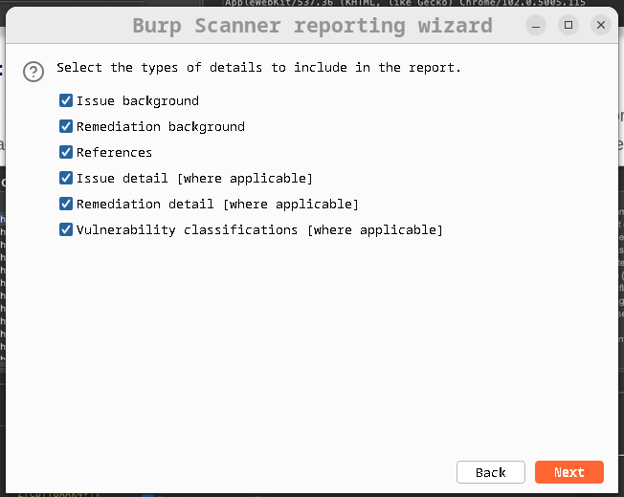
Step 2: Configure the report options

Slide 29
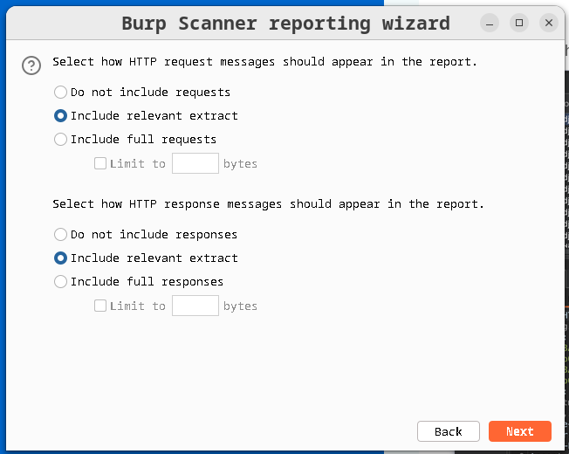
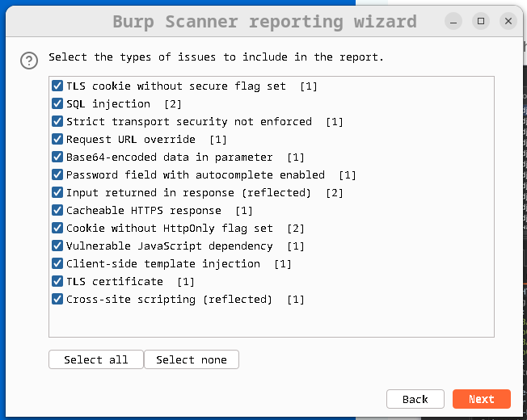
Step 2: Configure the report options

Slide 30
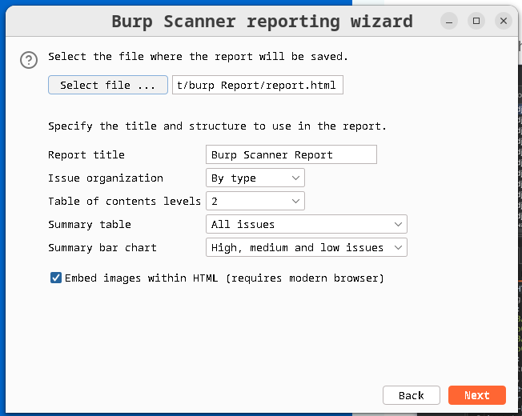
Step 2: Configure the report options

Slide 31
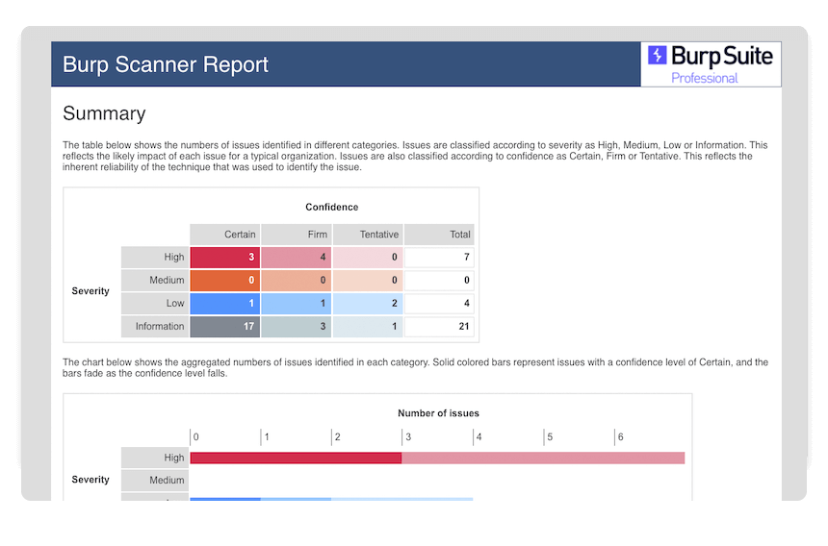
Step 3: Generating a Report

Slide 32
Observation/ Result:
The scanner identifies potential vulnerabilities such as SQL injection, Cross-Site Scripting (XSS), Cross-Site Request Forgery (CSRF),Client Side Templete Injection.
A list of identified vulnerabilities with details such as severity, affected URLs, and potential impact.The spider crawls the web application and identifies various pages and endpoints.The scanner gathers information about the web application, including its technology stack, server version, cookies, headers, etc.
Then Generating a Report.The Report provides a comprehensive overview of the findings and observations during the scanning process.

Slide 33
INTRUDER
Burp Intruder is a tool for automating customized attacks against web applications. It enables you to configure attacks that send the same HTTP request over and over again, inserting different payloads into predefined positions each time.

Slide 34
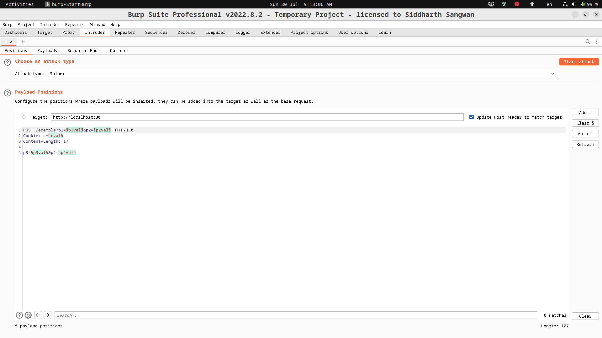
Experiment Design: (Setup)

Slide 35
Test Selection
Sniper attack and Brute Forces

Slide 36
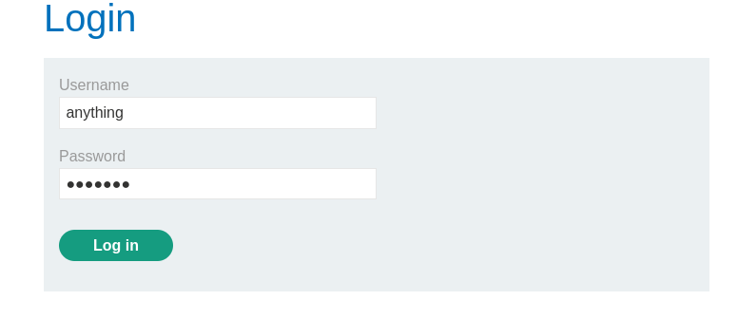
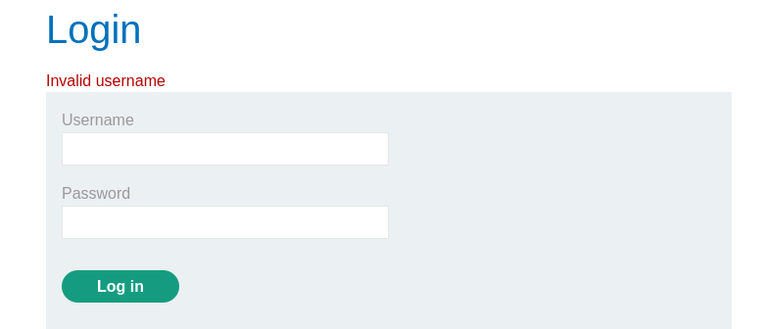
Test Step 01 : Try to log in

Slide 37
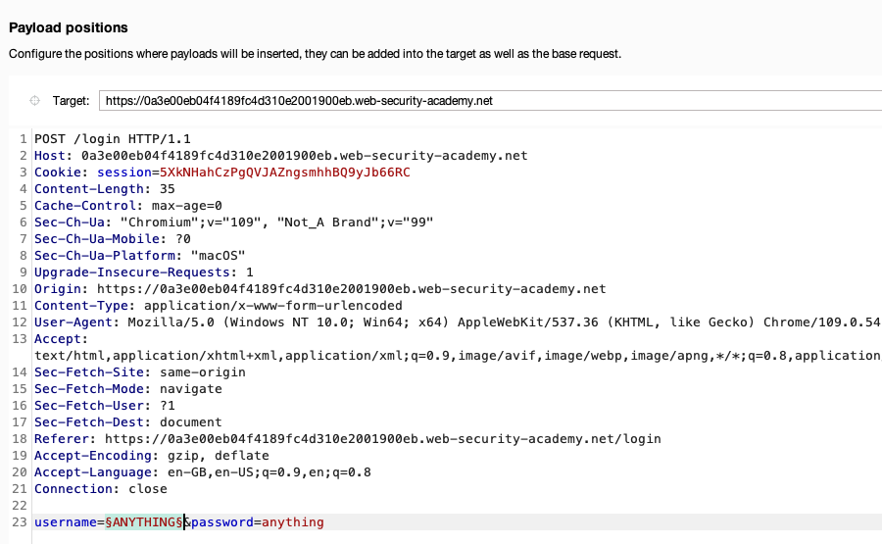
Step 02 : Find the POST /login
Step 03: Right click on the POST/ Login and send to the intruder.
Step 04: Set the payload Position.

Slide 38
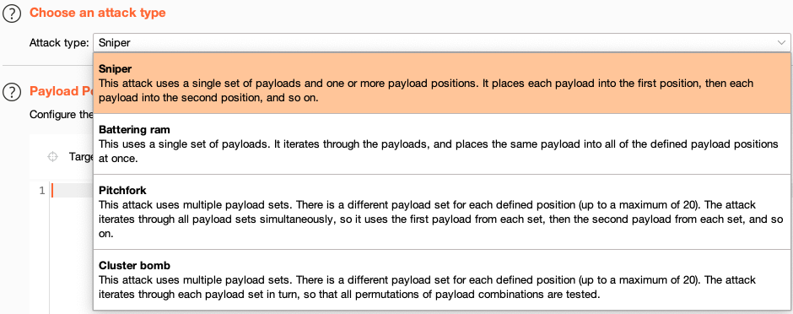
Step 05: Select The Attack Type

Slide 39
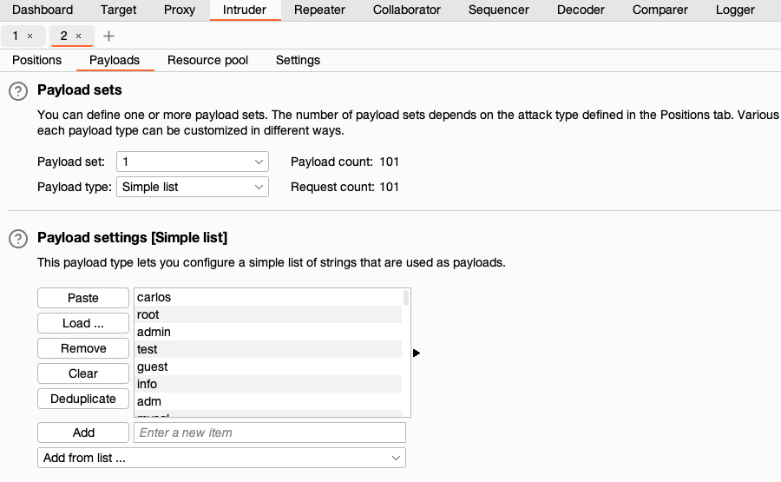
Step 06: Add the payloads

Slide 40
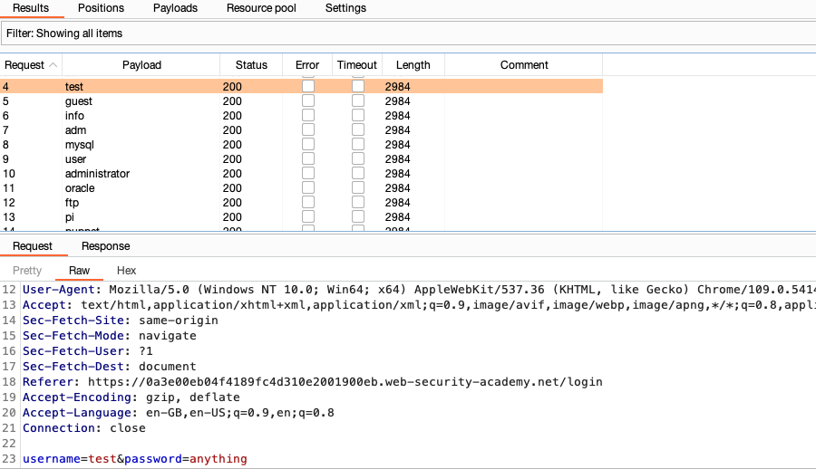
Step 07: Start the Attack

Slide 41
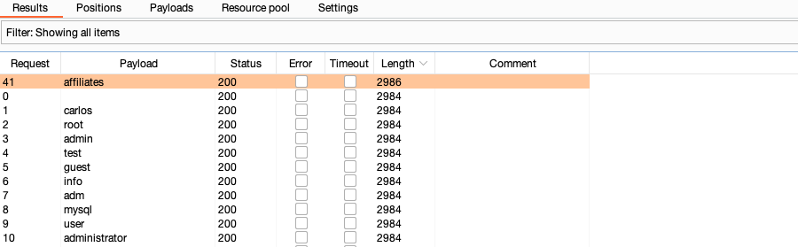
Step 08: Look for any irregular responses

Slide 42
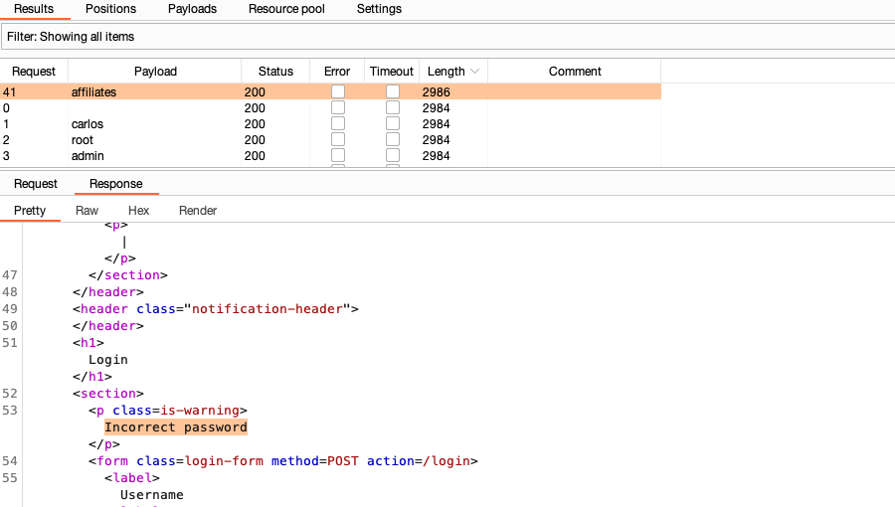
Step 09: Study the Response

Slide 43
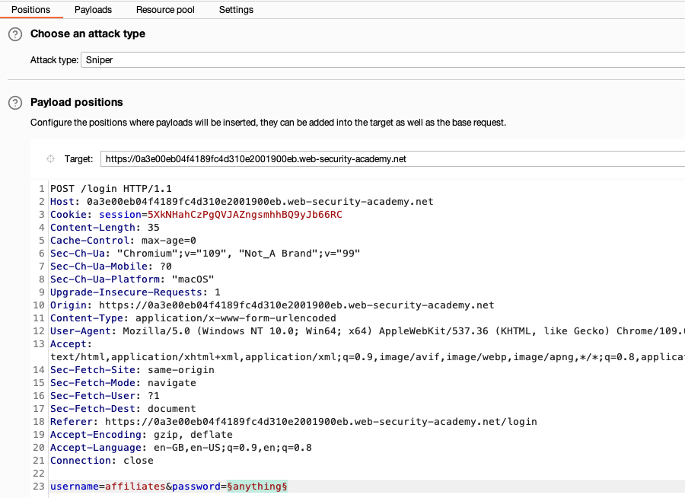
Step 10 : Now Brute Force the Password

Slide 44
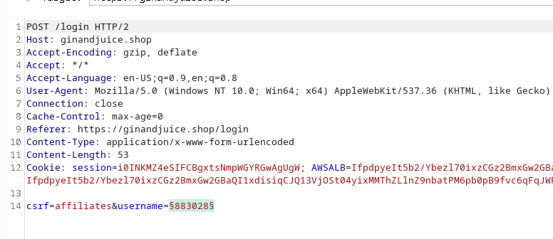
Step 10 : Now Brute Force the Password

Slide 45
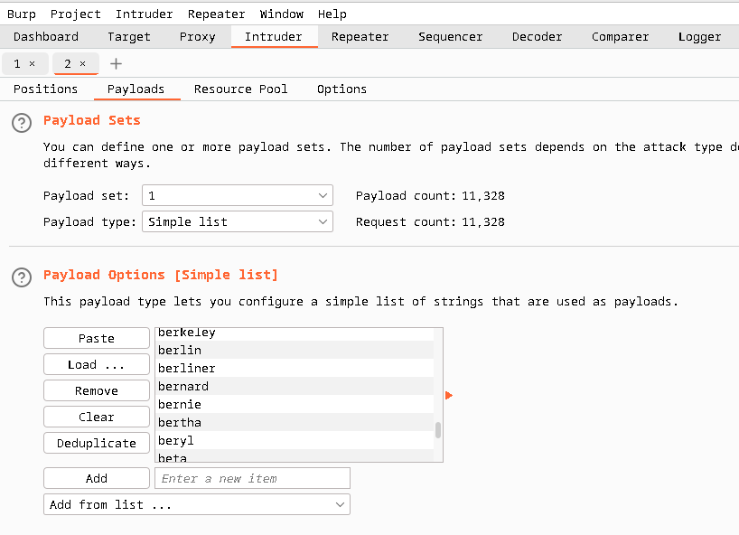
Step 10 : Now Brute Force the Password

Slide 46
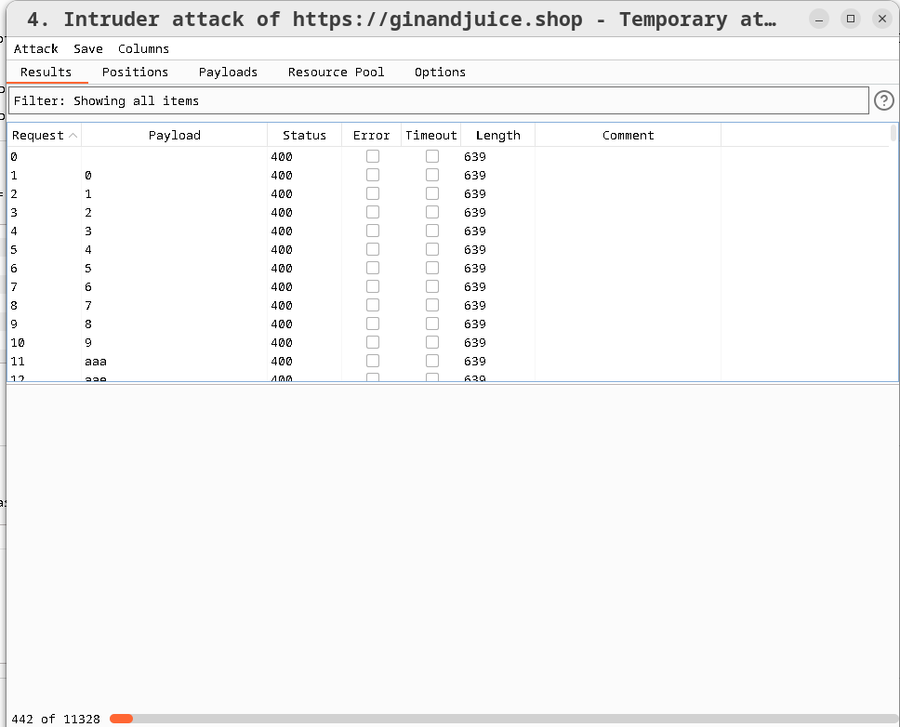
Step 10 : Now Brute Force the Password

Slide 47
Observation/ Result:
Here I do sniper attack which means the playloads are run only one’s. After running all the username payload i found a unusual length of response.Then i found that the username is correct but the password is incorrect then we do brute force in password field.After several payload we found the actual result and we logged in the blog websites.
For this, we run 11328 password to get the actual password.

Slide 48
REPEATER
Web application security testing module. It lets user manually modify and reissue HTTP/HTTPS requests to analyse how applications respond

Slide 49
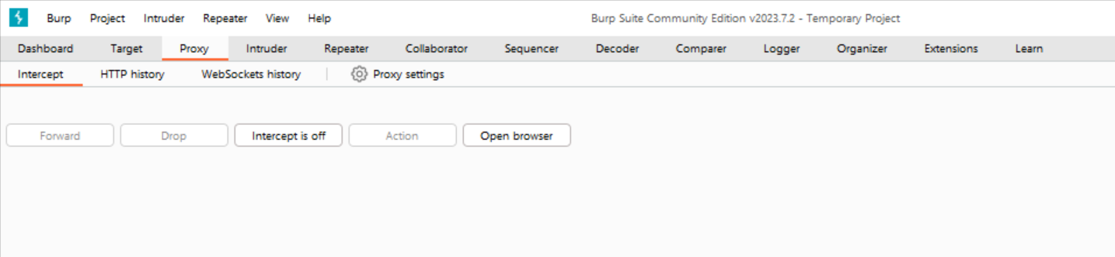
Experiment Design
Repeter Setup:

Slide 50
Test Selection:
Find out vulnerability.
Penetration testing

Slide 51
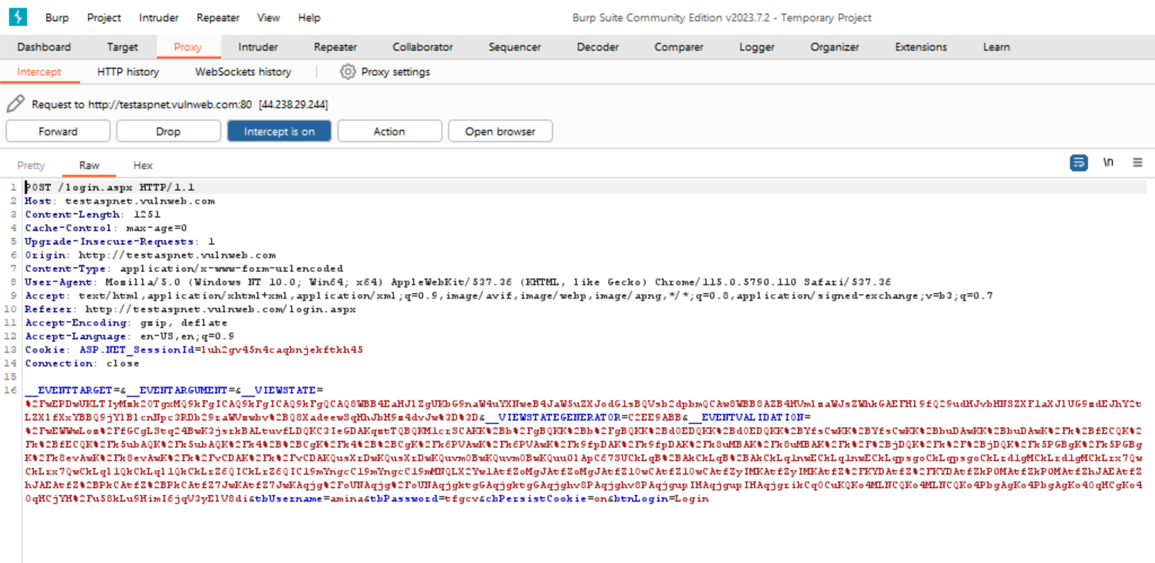
Test Step :
Worked on : http://testaspnet.vulnweb.com/

Slide 52
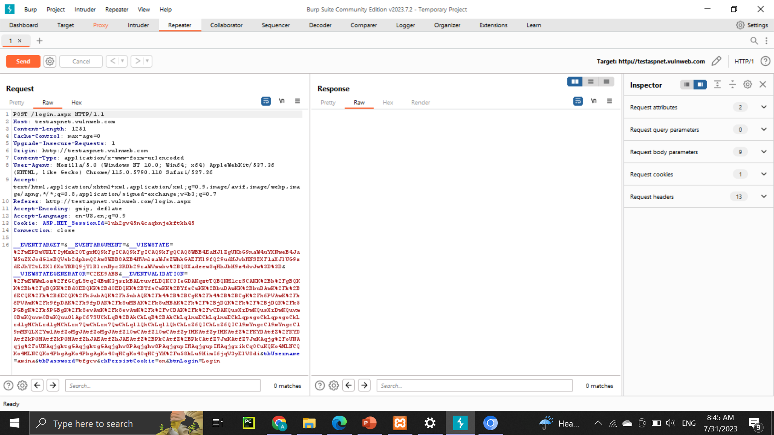
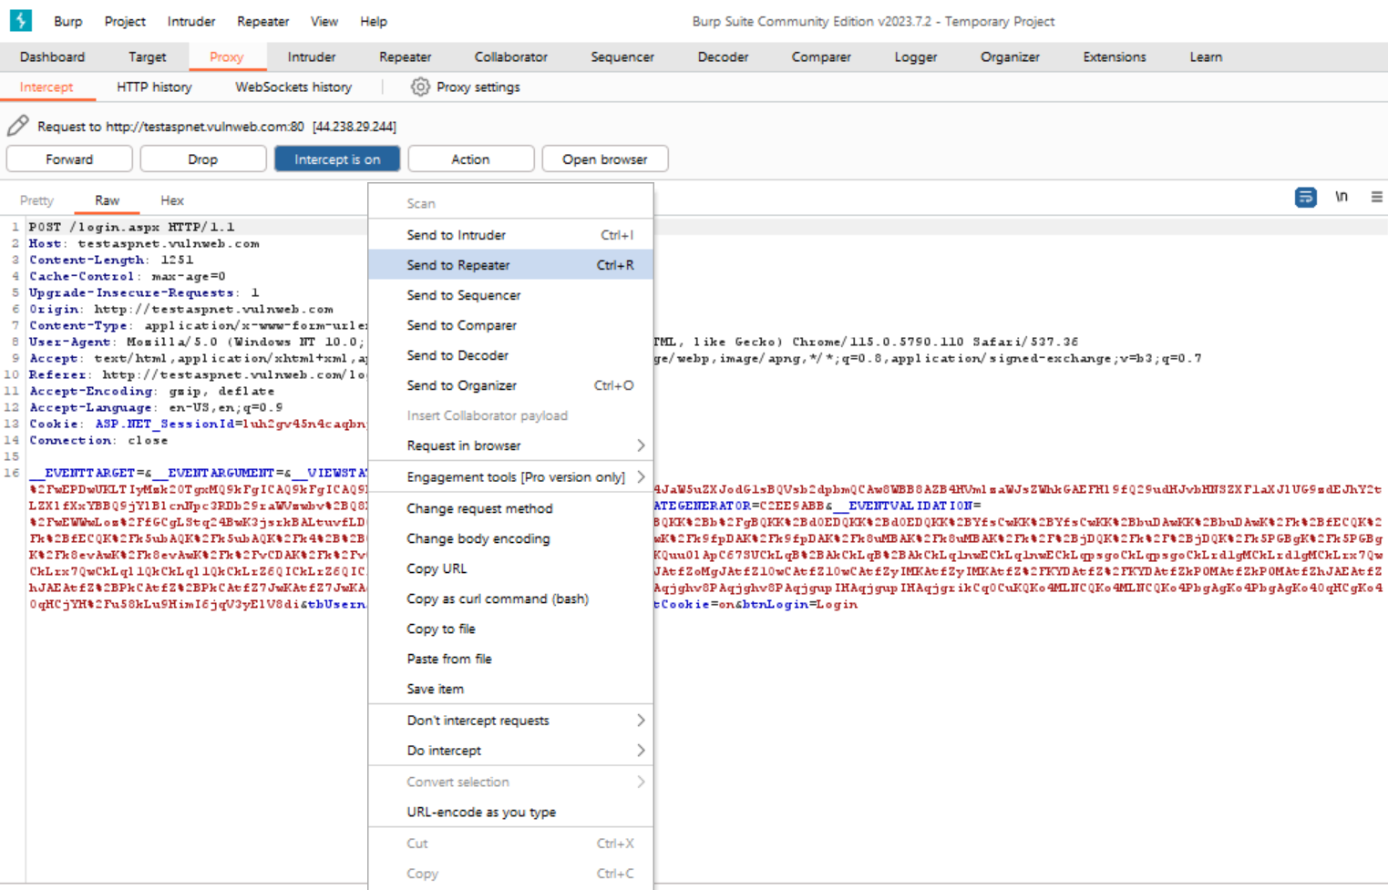
Test Step :
/

Slide 53
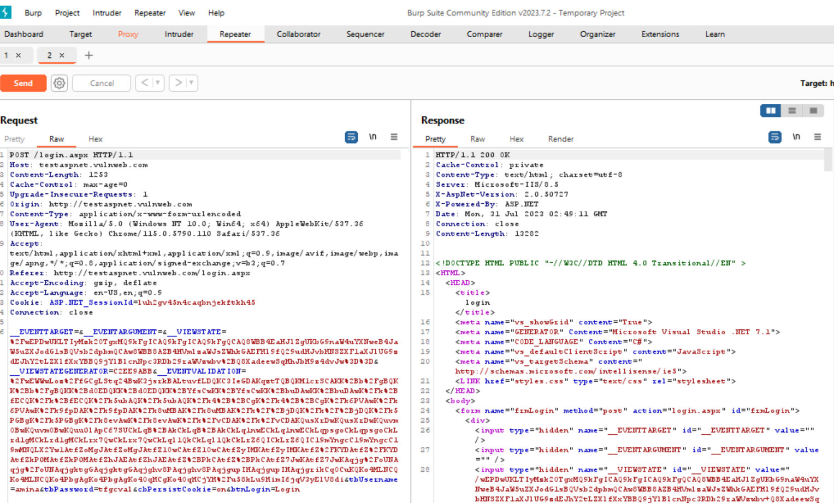

Test Step :
/

Slide 54
Challenges :
Some applications may limit the number of requests from particular IP address, or block it altogether if it suspects it's being attacked, which can interrupt testing

Slide 55
SEQUENCER
Burp Sequencer analyze the quality of randomness in a sample of tokens.

Slide 56
Experiment Design
Sequencer Setup:

Slide 57
Test Selection:
Obtaining a sample.
Sequencer settings.
Analysis results.

Slide 58
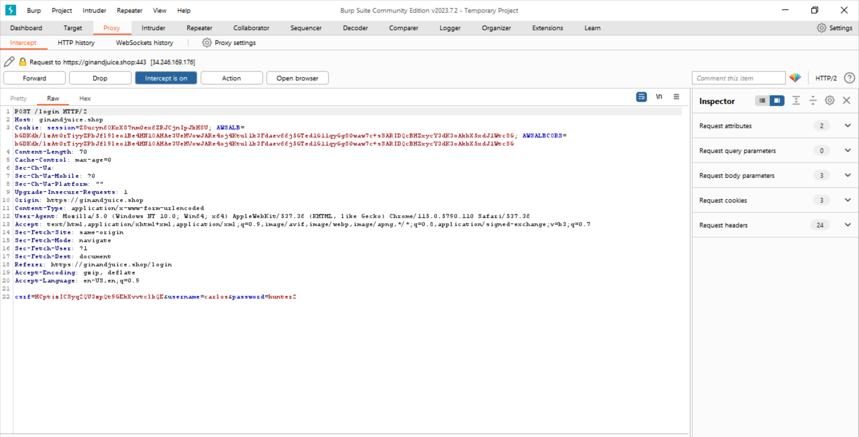
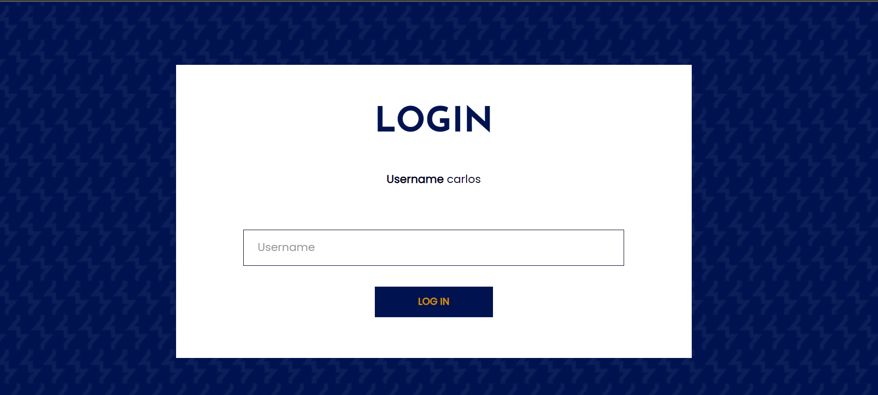
Test Step :
Work on : ginandjuice.shop

Slide 59
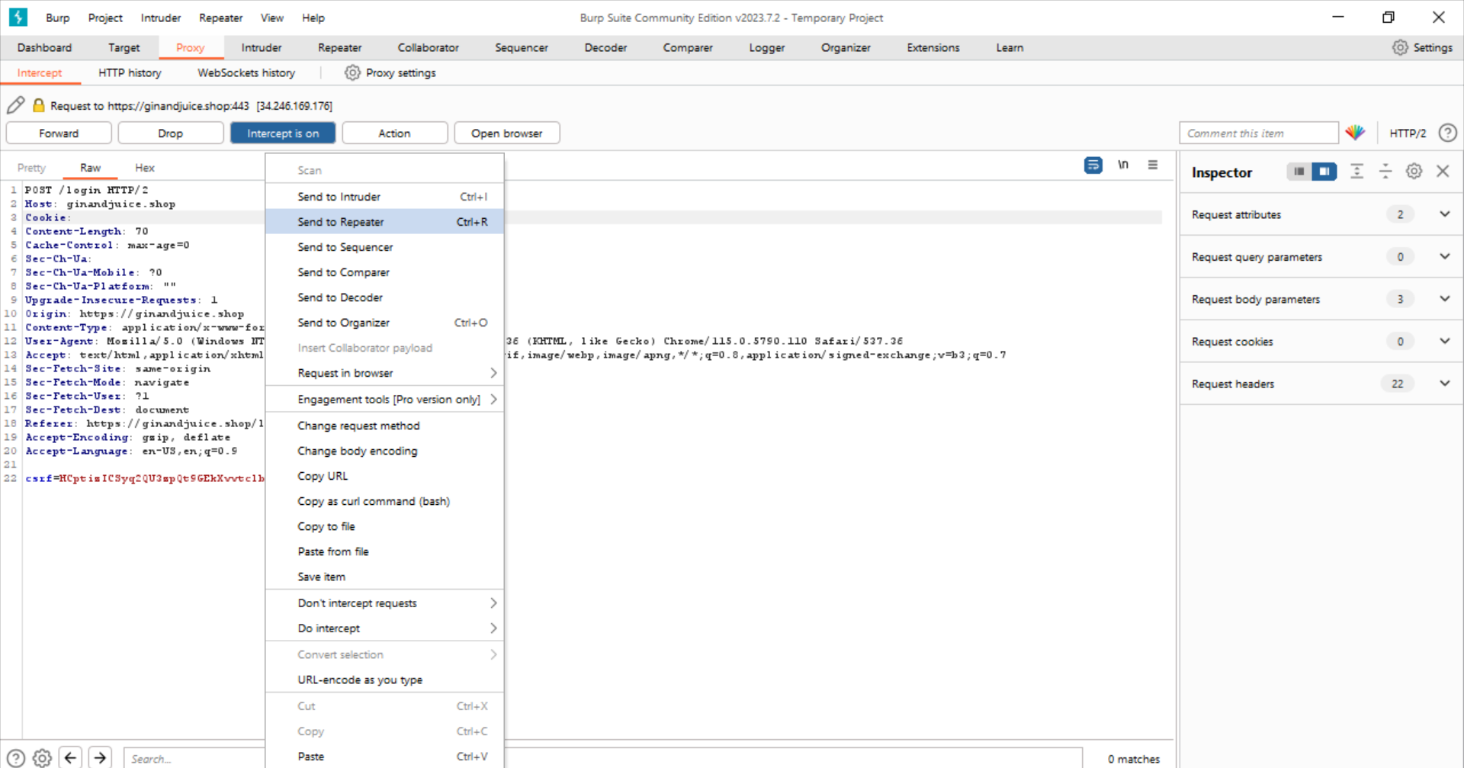

Slide 60
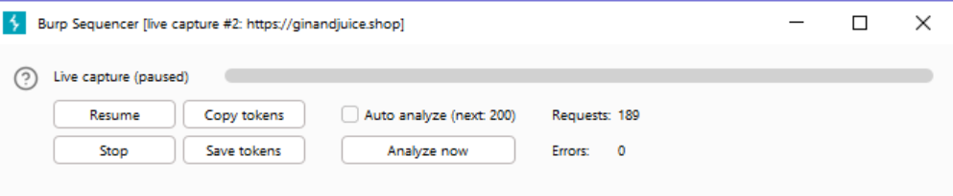
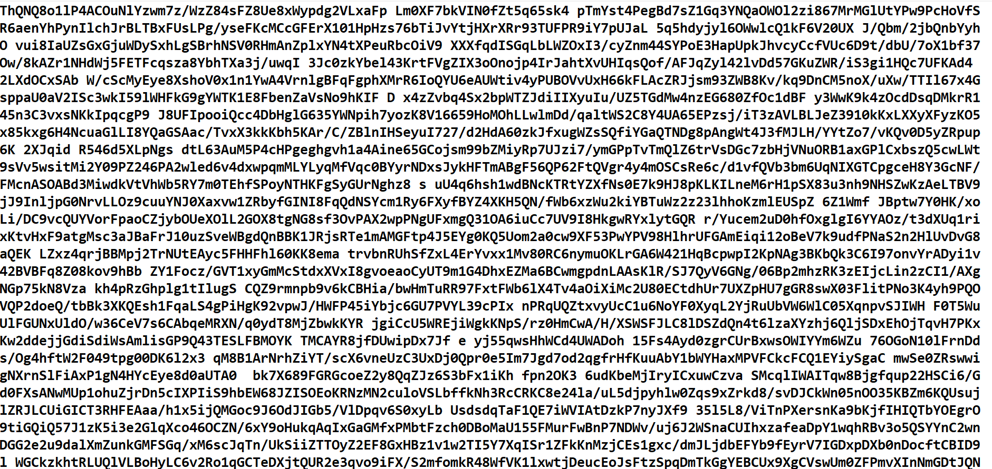

Slide 61
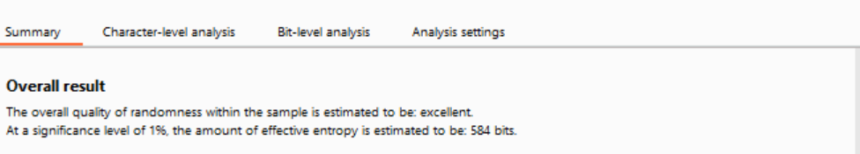
Result

Slide 62
Challenges :
Collecting a sufficient amount of data can be challenging. The Sequencer requires a large number of tokens to provide reliable result. This means the user must interact with the application extensively, which can be time-consuming

Slide 63
SOAP UI
Web service testing application
SoapUi is an open-source web service testing application for service-oriented architectures and representational state transfer.
Its functionality covers web service inspection,development,simulation and mocking, functional testing,load and compliance testing.

Slide 64
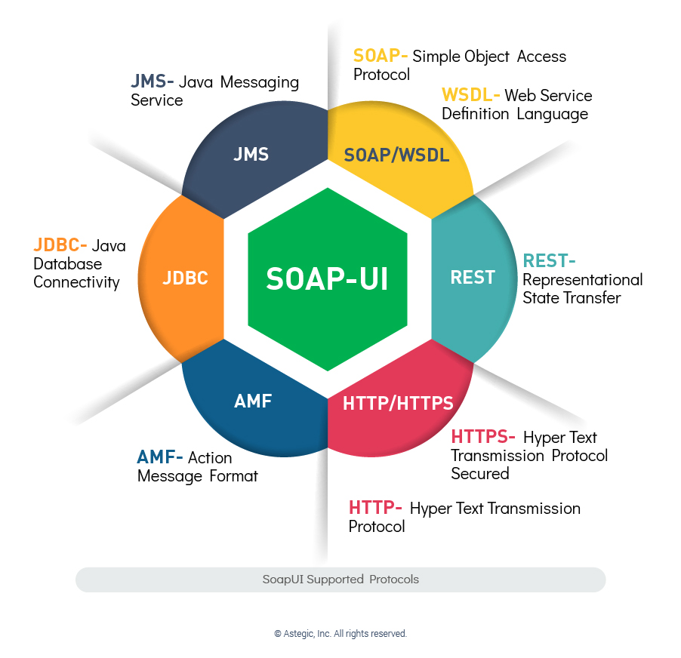

Slide 65

Web Service
A web service is any piece of
software that makes itself
available over the internet
and uses a standardized XML
messaging system.XML is used
to encode all communications
to a web service.
A web service is a collection of open protocols
and standards used for exchanging data between
applications or system

Slide 66
Why to use SoapUI
To create quick and efficient API tests
To create API functional,performance and security tests
To Create API Testing automation framework
API
API stands for Application programming Interface.
An API is a software intermediary that allows two applications tp talk to each other . In other words,
An API is the messenger that delivers your request to the provider that you’re requesting it from and then delivers the response back to you

Slide 67
WSDL
.WSDL(web services Description Language)is an XML based language which will be used to described the service s pffered by a web service.
.WSDL describes all the operations offered by the particular web service in the XML format. It also defines how the services can be called, what input value we have to provide and what will be the format of the response it is going to generate for each kind of service.

Slide 68


Experiment Design (setup)

Slide 69



Slide 70



Slide 71
Test Selection:
Functional
Performance
Security
Commonly used Custom SoapUI Properties
Global properties
Project properties
TestSuite properties
TestCase properties
TestStep properties

Slide 72


Global properties

Slide 73

Project properties

Slide 74


TestSuite properties & TestCase properties

Slide 75


TestStep properties

Slide 76



Slide 77
Result Summary:
Here we see a successful API request and Found expected data.That indicating the web service is functioning correctly.We measured the response time of API calls.This is crucial for performance testing to ensure that the API is responding within acceptable time limits
Challenges:
WSDL file upload problem
Code run problem

Slide 78
Thank You

